Slide 1
Scalable Deep Learning on Distributed Infrastructures:
Challenges, Techniques and Tools
户玉拓

Slide 2

目录
Scheduling and Elasticity
Single-tenant
Multi-tenant
Model Architecture and Hyper-parameter Search
Data Management
Training Data.
Model Data.
Comparison Of Deep-learning Frameworks
Conclusions

Slide 3
Scheduling and Elasticity
how to map the DL training processes to the processing nodes in the distributed infrastructure
single-tenant scheduling
multi-tenant scheduling
model architecture and hyper-parameter search

Slide 4
single-tenant scheduling
Which process is placed on which resource ?
When or in what order are the processes that are placed on the same resource executed?
When and how are the number of processes and/or resources adapted?

Slide 5
multi-tenant scheduling
In a multi-tenant environment, multiple training jobs share a common set of resources.
Mesos
YARN
Borg
the convergence rate of a training task varies over time
different DL training jobs may have very different training curves

Slide 6
Model Architecture and Hyper-parameter Search.
what is the best model architecture that can reach the best accuracy
what are the best hyper-parameter settings to reach model convergence quickly
The typical approach is to repeatedly try out different architectures and hyper-parameter settings to ﬁnd the best one

Slide 7
目录
Scheduling and Elasticity
Single-tenant
Multi-tenant
Model Architecture and Hyper-parameter Search
Data Management
Training Data.
Model Data.
Comparison Of Deep-learning Frameworks
Conclusions

Slide 8
Data Management
One of the great challenges of large-scale DL is handling the data that is involved.
Training Data
Model Data
fully trained
snapshots

Slide 9
Training Data.
Obtaining large labeled training data
manual labeling
training with highly noisy training data
preprocessing of the training data
normalization
Augmentation
distorted training data

Slide 10
Model Data.
Tracking
Storing
indexing

Slide 11
目录
Scheduling and Elasticity
Single-tenant
Multi-tenant
Model Architecture and Hyper-parameter Search
Data Management
Training Data.
Model Data.
Comparison Of Deep-learning Frameworks
Conclusions

Slide 12
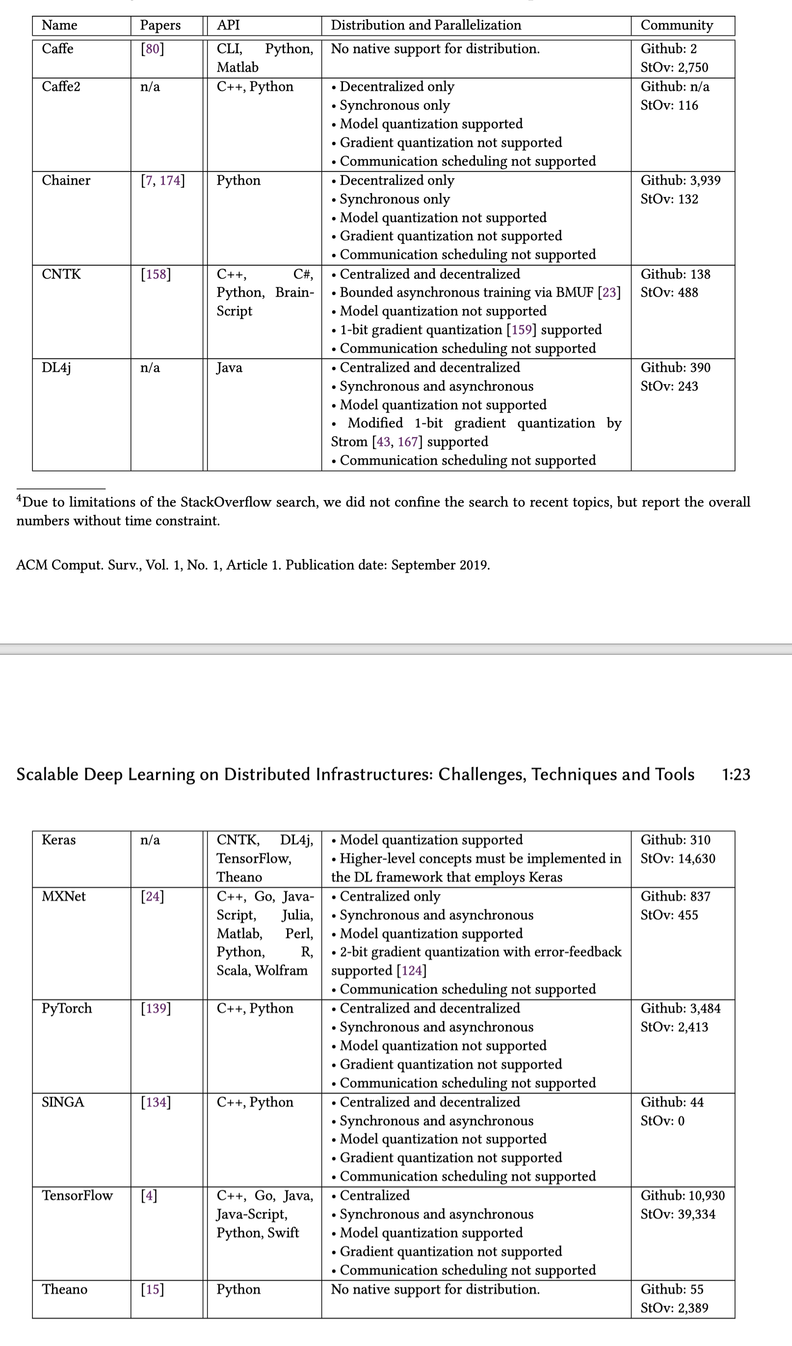
Comparison Of Deep-learning Frameworks
APIs
Support for distribution and parallelization
Community

Slide 13
目录
Scheduling and Elasticity
Single-tenant
Multi-tenant
Model Architecture and Hyper-parameter Search
Data Management
Training Data.
Model Data.
Comparison Of Deep-learning Frameworks
Conclusions

Slide 14
Conclusions
management of training and model data becomes a larger challenge
decentralized training may change the requirements and design of DL infrastructures and tools.
data management and multi-tenant scheduling need to be investigated

Slide 15
THANKS！

